Slide 1
Kinetics Lab (KIN) Prelab Presentation
Group Name: Just Diene (Group 6)
Instructor: Dr. Marat Orazov
Date: April 15th, 2021
Group Members:
Daniel Robinson Abdul Fayeed Neel Shah Evan Sciacchitano

Slide 2
TEAM ORGANIZATION AND ROLES
Group Leader: Daniel Robinson
Communication Coordinator: Abdul Fayeed
Data Coordinator: Neel Shah
Safety and Logistics Coordinator: Evan Sciacchitano
MATLAB and Data Analysis: All

Slide 3
OVERVIEW
Background/Objectives
Safety and Experimental Plan
Future planning
- Time management plan
- Data analysis
References

Slide 4
BACKGROUND

Slide 5
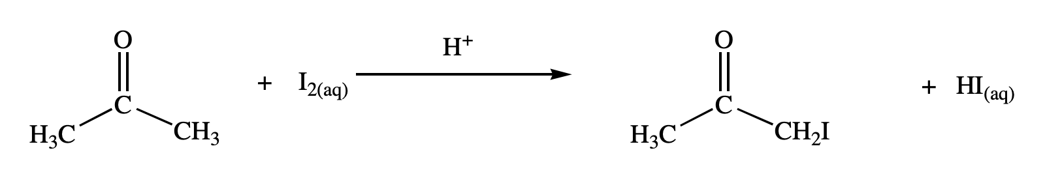


OBJECTIVES
Understand the mechanism of the reaction that models the iodination of acetone.
Use MATLAB p-code to simulate the experiment by varying the temperature, initial concentrations of acetone, hydrochloric acid, and iodine in several trials.
Analyze data and perform calculations to determine the order of each reactant, activation energy, and Arrhenius pre-exponential factor using the initial rates method.
$$k=Aexp(−\frac{E_{A}}{RT})$$
$$Rate=k{\left[Acetone\right]}^{α}{\left[HCl\right]}^{β}{\left[I_{2}\right]}^{γ}$$
Iodination of Acetone. https://studylib.net/doc/8752869/iodination-of-acetone (accessed Apr 15, 2021).
Orazov, M. CHEG 345 Kinetics Experiment. Chemical Engineering Laboratory I: CHEG 345. University of Delaware
Notes:
IN ORDER: Acetone + Iodine + HCl (acid catalyze) -> Iodo-acetone + Hydrogen Iodide

Slide 6
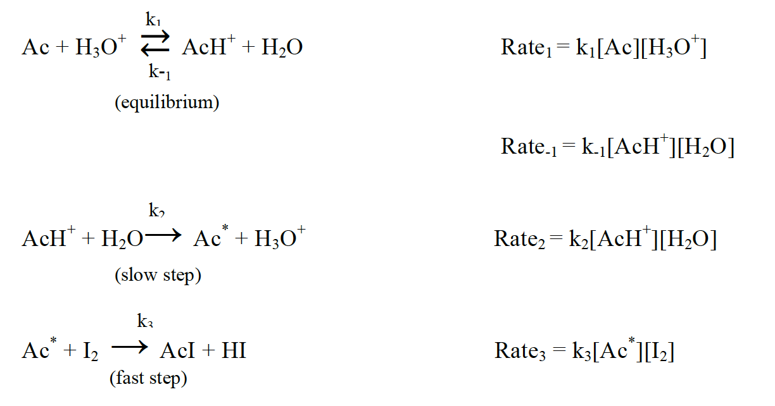
REACTION MECHANISMS
The second step of the mechanism is determined to be the rate determining step.
The rate law is predicted to be first-order in both acetone and hydrochloric acid and zeroth-order in iodine. This must be determined from the experiment.
Orazov, M. CHEG 345 Kinetics Experiment. Chemical Engineering Laboratory I: CHEG 345. University of Delaware

Slide 7
SAFETY AND EXPERIMENTAL PLAN

Slide 8
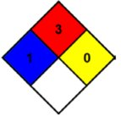
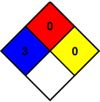
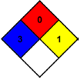
CHEMICAL HAZARDS
NFPA Diamond for Acetone ¹, Iodine ², 1 M Hydrochloric Acid ³, and Hydrogen Iodide ⁴
¹ Acetone; CAS No. 67-64-1 [Online]; LabChem, Inc; Zelienople, PA, November 12, 1998. https://www.labchem.com/tools/msds/msds/LC10420.pdf (accessed 4/14/21)
² Iodine; CAS No. 7553-56-2 [Online]; LabChem, Inc; Zelienople, PA, November 4, 2003. http://www.labchem.com/tools/msds/msds/LC15590.pdf (accessed 4/14/21)
³ Hydrochloric Acid; CAS No. 7647-01-0 [Online]; LabChem, Inc; Zelienople, PA, July 3, 2013. https://www.labchem.com/tools/msds/msds/LC15300.pdf (accessed 4/14/21)
⁴ Hydrogen Iodide; CAS No. 10034-85-2 [Online]; Matheson Tri-Gas, Inc; Basking Ridge, NJ, March 7, 1990. https://www.mathesongas.com/pdfs/msds/MAT11100.pdf (accessed 4/14/21)

Slide 9
CHEMICAL EXPOSURE GUIDELINES
Inhalation
Splash
Ingestion
Assist exposed person to fresh air
Call UD Police
Provide CPR if needed and trained
Retrieve SDS and provide it to medical providers
Assist exposed person to safety shower/eyewash
Call UD Police
Remove all contaminated apparel
Retrieve SDS for medical providers
Neoprene gloves must be worn when handling Iodine
Rinse mouth thoroughly
Call UD police
Do not induce vomiting
Have individual drink sips of water
Retrieve SDS for medical providers

Slide 10
OPERATIONAL HAZARDS AND PRECAUTIONS
Potential Hazards
Precautions
Sharp Objects:
Needle on the syringes
Fire:
Acetone has a flash point of -20°C
Sharp Objects:
Extra precaution and wear proper PPE
Fire:
Remove any sources of ignition from lab

Slide 11
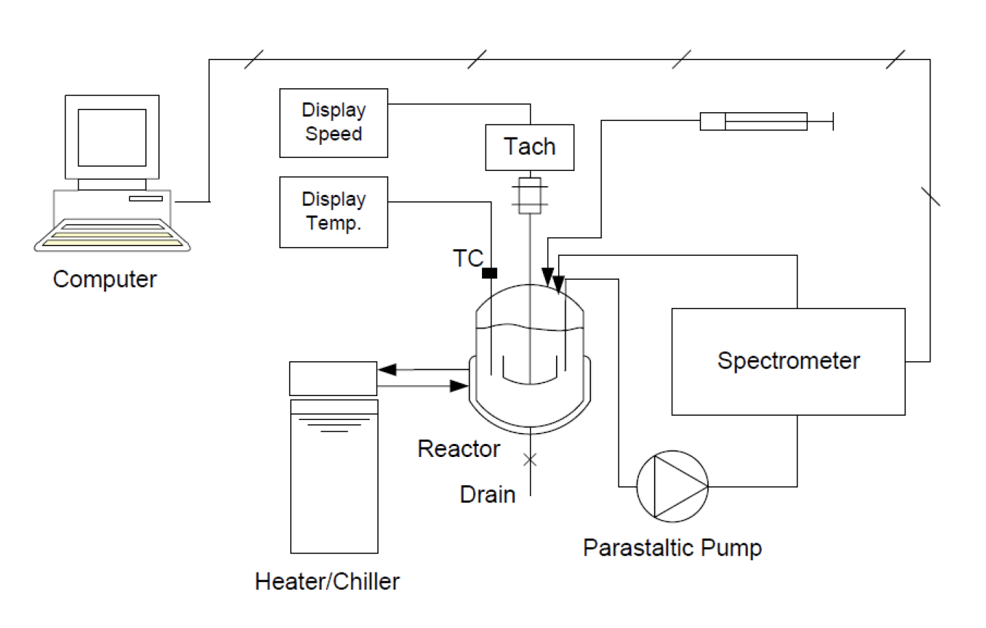
EXPERIMENTAL PLAN
Ensure proper PPE is being worn
Locate the chemical and waste disposal sites
Connect hose to waste container and turn on instruments
Perfom standard lab work, such as rinsing reactor 3 times with distilled water
Measure and add desired amount of water
Switch on agitator, then measure and add acetone using a funnel.
Once desired temperature is reached, measure and inject HCL
Start circulating pump, calibrate the spectrometer
Measure and inject iodine
After about the first 200 seconds, stop recording and save data
Turn off all instruments, drain the reactor, and repeat for each run
Orazov, M. CHEG 345 Kinetics Experiment. Chemical Engineering Laboratory I: CHEG 345. University of Delaware

Slide 12
FUTURE PLANNING

Slide 13
TIME MANAGEMENT PLAN
Week 3, Monday, 4/19/21:
Simulate All Data in MATLAB – Evan and Abdul
Week 3, Wednesday, 4/21/21:
Perform General Statistical Analysis – Dan and Neel
Week 4, Monday, 4/26/21:
Prepare Memo Report and Update – Everyone
Week 5, Monday, 5/03/21:
Create MATLAB and/or ASPEN Models – Abdul and Dan
Week 6, Monday, 5/10/21:
Prepare Final Report and Presentation – Everyone
Week 7, Monday, 5/17/21:
Revise Final Report – Everyone

Slide 14
INITIAL CONDITIONS
Run # | Temperature (°C) | [Acetone]₀ (M) | [HCl]₀ (M) | [I₂]₀ (M)
1 | 35 | 2 | 0.02 | 0.0020
2 | 35 | 1 | 0.02 | 0.0020
3 | 35 | 3 | 0.02 | 0.0020
4 | 35 | 4 | 0.02 | 0.0020
5 | 35 | 2 | 0.01 | 0.0020
6 | 35 | 2 | 0.03 | 0.0020
7 | 35 | 2 | 0.04 | 0.0020
8 | 35 | 2 | 0.02 | 0.0010
9 | 35 | 2 | 0.02 | 0.0030
10 | 35 | 2 | 0.02 | 0.0040
11 | 30 | 2 | 0.02 | 0.0020
12 | 33 | 2 | 0.02 | 0.0020
13 | 40 | 2 | 0.02 | 0.0020
Time = 180 s/run
Standard Concentration:
[Acetone]₀ = 1.98 M
[HCl]₀ = 0.0199 M
[I₂]₀ = 0.00162 M
T ~ 30 - 40 °C

Slide 15
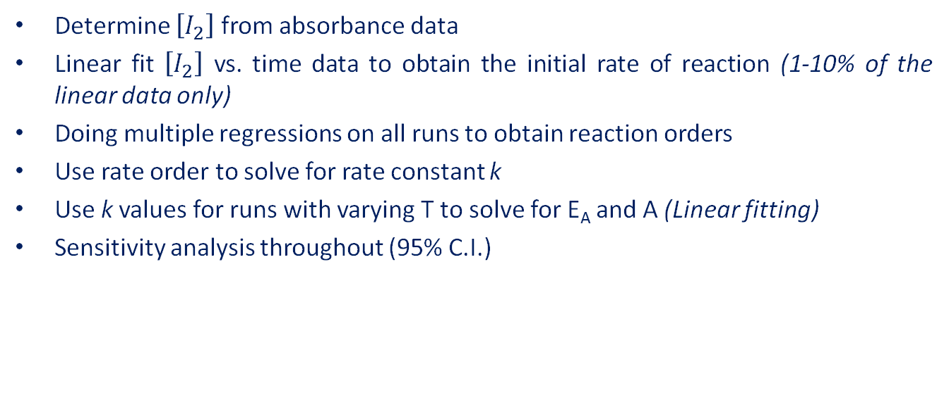
DATA ANALYSIS
Determine $\left[I_{2}\right]$ from absorbance data
Linear fit $\left[I_{2}\right]$ vs. time data to obtain the initial rate of reaction (1-10% of the linear data only)
Doing multiple regressions on all runs to obtain reaction orders
Use rate order to solve for rate constant k
Use k values for runs with varying T to solve for E_{A} and A (Linear fitting)
Sensitivity analysis throughout (95% C.I.)

Slide 16
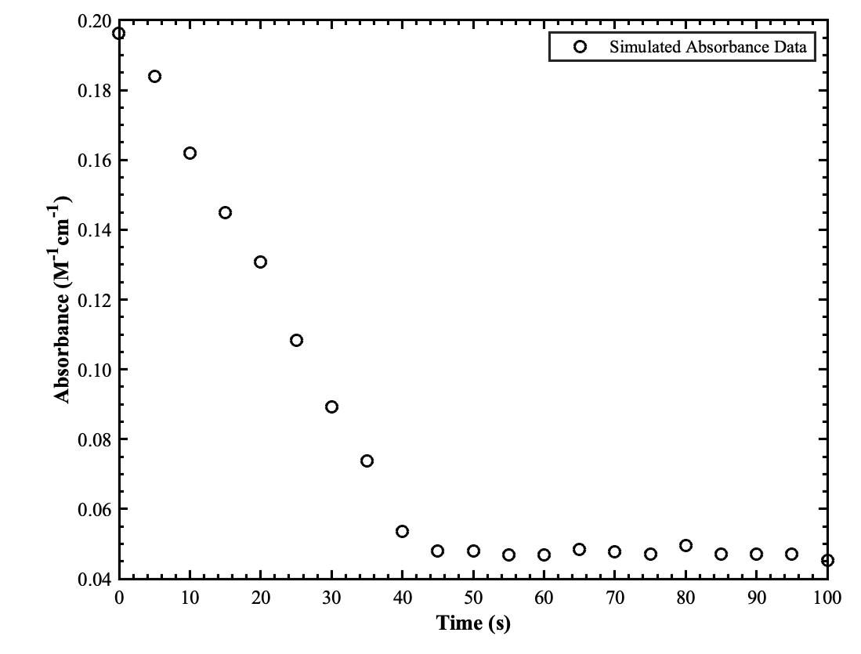
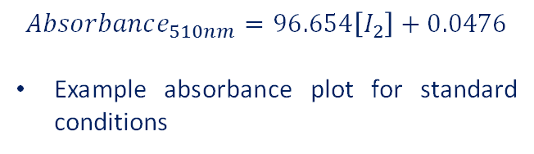
P-CODE EXAMPLE
$$Absorbance_{510nm}=96.654\left[I_{2}\right]+0.0476$$
Example absorbance plot for standard conditions

Slide 17
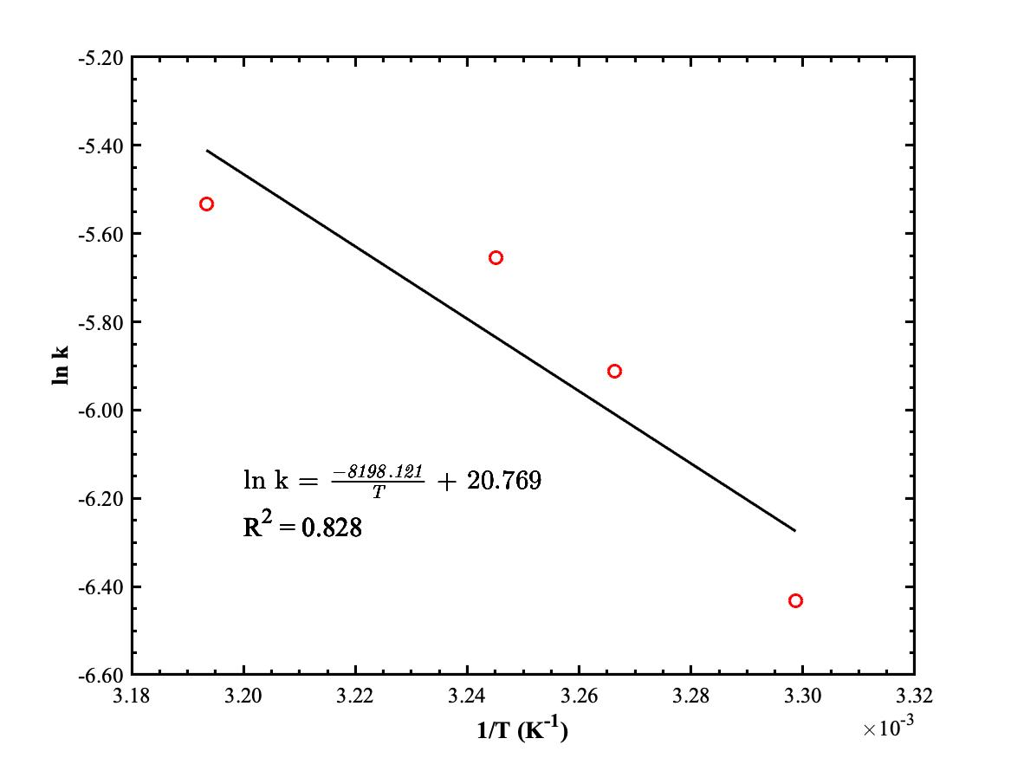
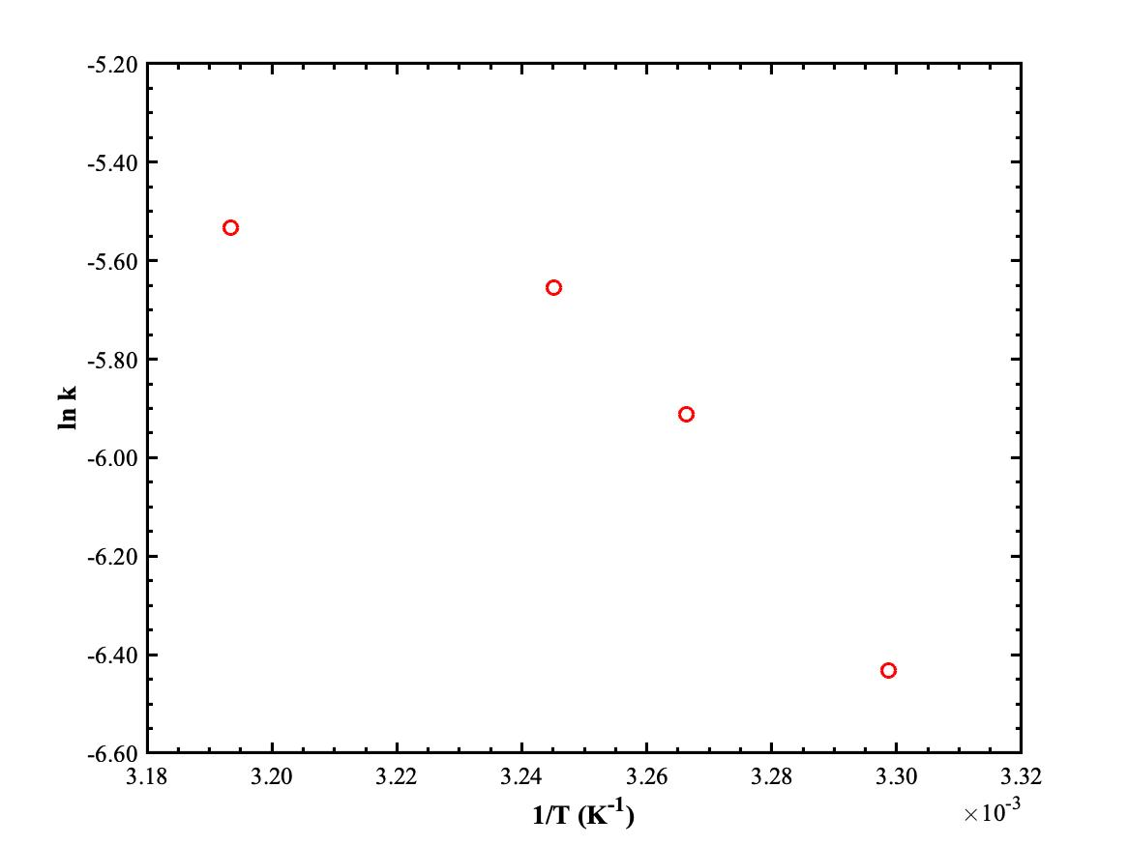
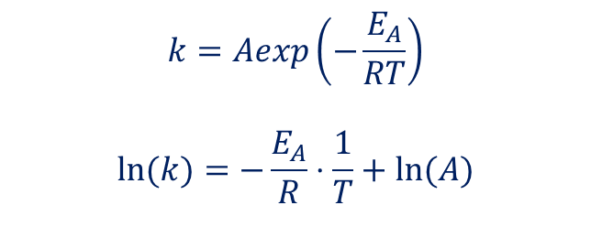
ARRHENIUS PLOT
$$k=Aexp\left(−\frac{E_{A}}{RT}\right)$$
$$ln⁡(k)=−\frac{E_{A}}{R}⋅\frac{1}{T}+ln⁡(A)$$

Slide 18
REFERENCES
Iodination of Acetone. https://studylib.net/doc/8752869/iodination-of-acetone (accessed Apr 15, 2021).
Orazov, M. CHEG 345 Kinetics Experiment. Chemical Engineering Laboratory I: CHEG 345. University of Delaware
Acetone; CAS No. 67-64-1 [Online]; LabChem, Inc; Zelienople, PA, November 12, 1998. https://www.labchem.com/tools/msds/msds/LC10420.pdf (accessed 4/14/21)
Iodine; CAS No. 7553-56-2 [Online]; LabChem, Inc; Zelienople, PA, November 4, 2003. http://www.labchem.com/tools/msds/msds/LC15590.pdf (accessed 4/14/21)
Hydrochloric Acid; CAS No. 7647-01-0 [Online]; LabChem, Inc; Zelienople, PA, July 3, 2013. https://www.labchem.com/tools/msds/msds/LC15300.pdf (accessed 4/14/21)
Hydrogen Iodide; CAS No. 10034-85-2 [Online]; Matheson Tri-Gas, Inc; Basking Ridge, NJ, March 7, 1990. https://www.mathesongas.com/pdfs/msds/MAT11100.pdf (accessed 4/14/21)

Slide 19
THANK YOU!

